Slide 1
Deadlift Form Assessment System
Using yolov8n-pose and Raspberry Pi 5 + Hailo Hat+
Group 4:
Tran Trung Nghia, Igor Becker, Peng Tianyu, Bui Le Nhat

Slide 2
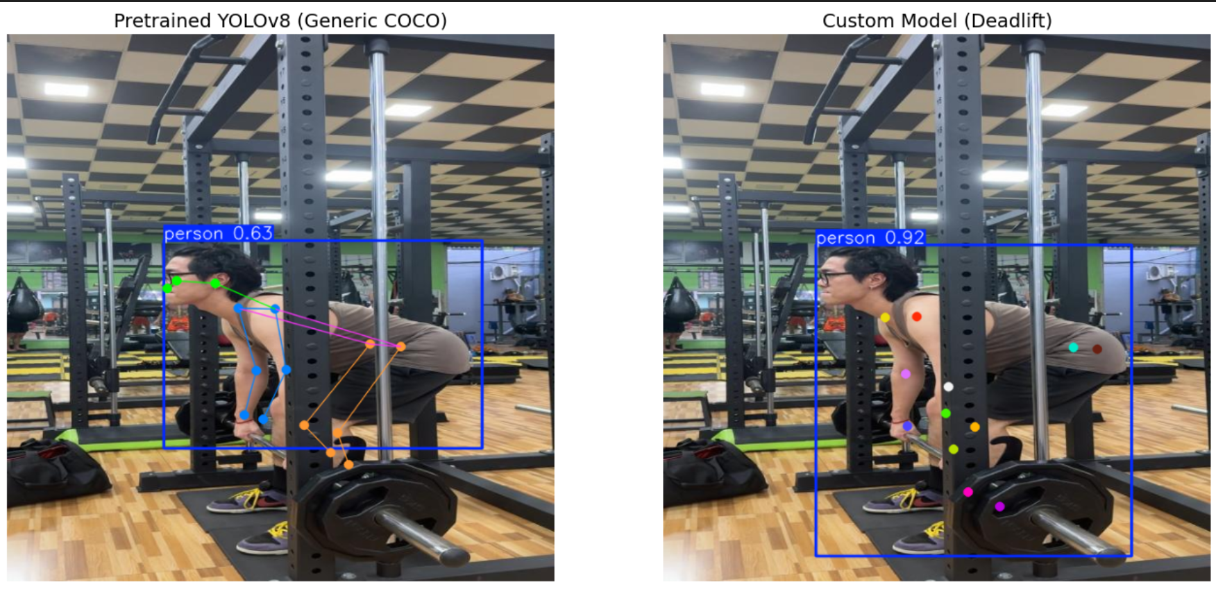
What Have We Achieved
Add more data to dataset and add blur augmentation to simulate motion blur in videos
Compare custom trained model with pre-trained model

Slide 3
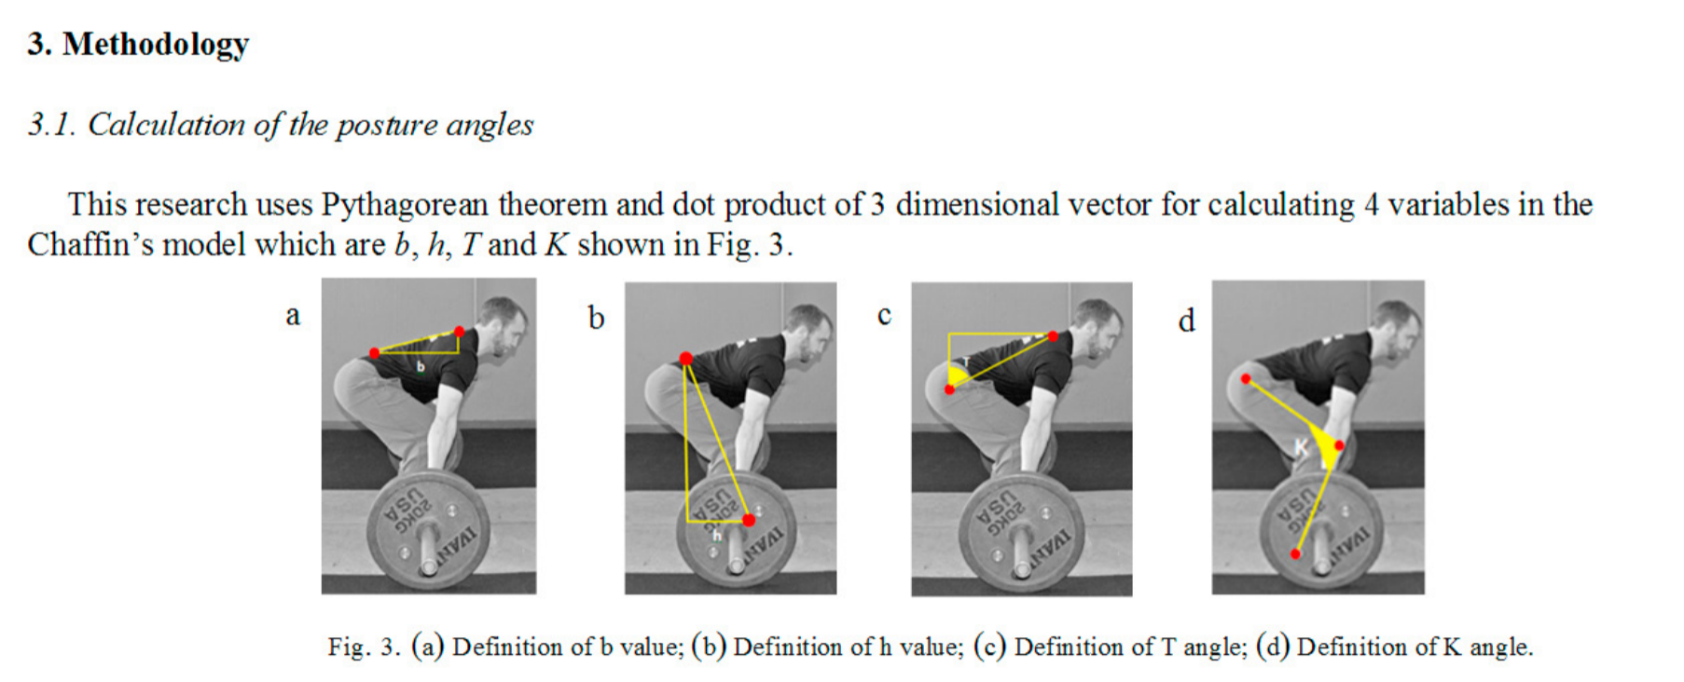
Next Steps
Use pre-trained yolov8n-pose instead of trying to fine tune it.
Implement Chaffin’s Model to Assess Deadlift Videos.

